Slide 1
Vehicle Tracking System
<<Speaker Name Here>>
<<For questions about this presentation contact Speaker Name speaker@us.ibm.com>>

Slide 2

Need of the hour
An organization or an Industry maintains a fleet of vehicles. Be it Banking industry, services sector, cab services etc, that are used to transport personnel, goods, cash etc, from one designated location to another designated location.
These industries or organizations need to keep tabs on the following:
  Spot the vehicle.
  Fuel Theft.
  Diversion from designated route.
  Speed of the vehicle.
  Unplanned stoppages.
  And many more…
Notes:
Let's first understand the high level concept of vehicle tracking system and why the industries needs this. A vehicle tracking system as name depicts is the system implemented to track the vehicle real time.
Different industries or organizations may it be a banking, logistics , cab services or service sectors maintains their own vehicles. For efficient operation of these vehicles the organization looks for the system
which enables them to :
Spot the vehicle at any given time,
Efficient route mapping
Identify fuel pilferage
Identify the vehicles
Diverting from designated route
over speading
taking unplanned stopages
Identify nearest vehicle

Slide 3
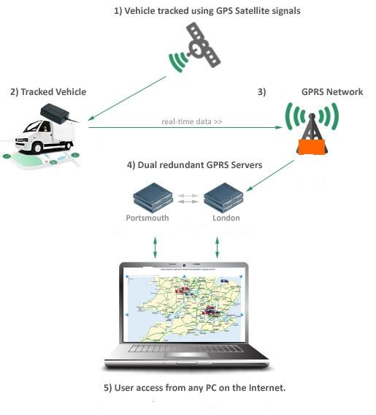
Basic Architecture Vehicle Tracking System
Notes:
The basic architecture of such system leverage on GPS & GPRS network. A vehicle is deployed with the device called vehicle tracking device, which has a capability of recording current location of vehicle, current fuel status, ignition status and current speed. This device then sends all this information to centralized computer system through GPRS network with certain frequency say every 10sec.
The analytics/intelligence is developed around this information to address the use cases discussed in previous slide.

Slide 4

Relational Representation
Fleet Example:
Vehicle Tracking
Primary Key
vhle_id
datetime
fuel
latlong
1
2010-11-02 01:00:00.00000
val1
val2
1
2010-11-02 01:05:00.00000
val1
val2
1
2010-11-02 01:10:00.00000
val1
val2
...
val1
val2
2010-11-02 01:00:00.00000
13
2010-11-02 01:00:00.00000
val1
val2
13
2010-11-02 01:05:00.00000
val1
val2
13
2010-11-02 01:10:00.00000
val1
val2
...
2010-11-02 01:00:00.00000
val1
val2
Notes:
The traditional approach to design database for such solutions is to store individual record for every 10sec reading. Which eventually stores the data in the form as show in this picture. For faster retrieval of information the primary key is built on vehicle_id and timestamp.

Slide 5
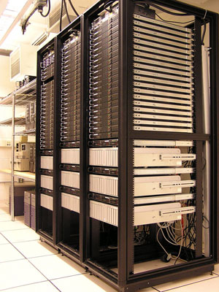
Challenges with traditional RDBMS approach
Stores one row per time stamped information.
Voluminous data.
Transactions are computationally expensive and take time.
Storage cost is high.
Many aspects of business semantics has to be handled by applications.
Notes:
Saying so, the traditional relational approach adds challenges as :
a – data growing hugely
b – transactions become expensive
c – experience low performance
d – requires high storage and maintenance cost
e – many aspects of business semantics has to be handled by application

Slide 6
Solution from IBM Informix
The proposed solution to the case mentioned earlier uses IBM Informix database extended by TimeSeries Datablade and Spatial Datablade:
  IBM Informix v11.50
  IBM Informix Time Series Datablade Module v4.01.TC8
  IBM Informix Spatial Datablade Module v8.21.TC3
Notes:
Informix technology proposes TimeSeries feature to address before said challenges with humongous data. And the Spatial feature to manage location based information efficiently and make development easy.

Slide 7
Relational Time Series Representation
Fleet Example:
Vehicle Tracking
vhle_id
Series
(int) timeseries(daybar)
1
[datetime, v1, ...)(Tue,v1…)]
2
[datetime, v1, ...)(Tue,v1…)]
3
[datetime, v1, ...)(Tue,v1…)]
4
[datetime, v1, ...)(Tue,v1…)]
…
…
Notes:
Informix Timeseries stores time stamped data for individual vehicle at column level. Hence the value of vehicle_id is not repeated like standard relational approach. The number of
rows in a table is far less. A primary is key defined on vehicle_id. As the number of rows are far less, the index tree is small. The data for each vehicle is physically order as per timestamp.
As the index tree is small and the data is physically ordered, the performance is extremely high.

Slide 8
Informix TimeSeries
Manages Time stamped data:
  A set of data where each item is time-stamped.
  Think of an array where each element can be indexed by time or by a timestamp.
Performance:
  Extremely fast data access
    Data layout optimized on disk.
    33 times faster than traditional RDBMS.
  Handles operations hard or impossible to do in standard SQL
Space Savings:
  Can be over 50% space savings over standard relational layout.
Analysis:
  Rich set of built-in routines.
Toolkit approach allows you to develop your own algorithms:
  Algorithms run in the database to leverage buffer pool.
Inter-operates with other features of RDBMS well.
Notes:
The TimeSeries is inbuilt feature of Informix, specially designed to manage the time stamped data and fulfill the needs of solutions developed to manage it. As the data lay out is optimized on disk, the performance is almost 33 times better than relational approach.
The built-in SQL routines helps to handle operations which otherwise are impossible to do in standard RDBMS. The optimized data lay out can save 50% of disk space compared to relational approach.
TimeSeries being in-built feature of server, it interoperates well with other features of database and other products making it easy to fit in solution architecture.

Slide 9
Informix Spatial (1)
Informix Spatial DataBlade Module treats the Earth as a flat map. It uses planimetric geometry, which means that it approximates the round surface of the Earth by projecting it onto flat planes using various transformations.
The Spatial DataBlade module is best used for regional datasets and applications.
The Informix Geodetic DataBlade Module treats the earth Round.
Notes:
Vehicle tracking system being the partially location based information management system, the spatial data supports plays major role in managing location based information of vehicle efficiently.
The spatial data support helps in storing the vehicle routes and location efficiently and the R-Tree index support helps faster retrieval. The SQL functions to create KML and GML files from the spatial data helps faster development.

Slide 10
Informix Spatial (2)
Informix R-tree support allows faster, more efficient indexing to improve performance of spatial data loads and queries.
Intuitive Spatial DataTypes allow easier integration for ISV’s and customers by shortening the learning curve.
More flexibility (with GML, KML and WFS) in external representation speeds integration.
Native spatio-temporal types for performance with complex queries involving space and time.
Automatic validation of spatial types improves data accuracy.
Notes:
Vehicle tracking system being the partially location based information management system, the spatial data supports plays major role in managing location based information of vehicle efficiently.
The spatial data support helps in storing the vehicle routes and location efficiently and the R-Tree index support helps faster retrieval. The SQL functions to create KML and GML files from the spatial data helps faster development.

Slide 11
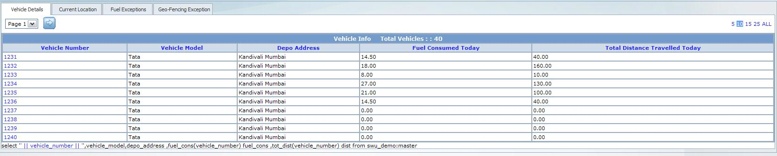
Fleet of Vehicles
Notes:
One can write simple function like fuel_cons and call it in select query as mentioned above to get fuel consumed details for given period. TimeSeries allows you to develop procedures/functions. The above pictures show the list of available vehicles. One can click on any vehicle number to get its current location on google map. The next slide shows the output when you click on vehicle number 1232

Slide 12
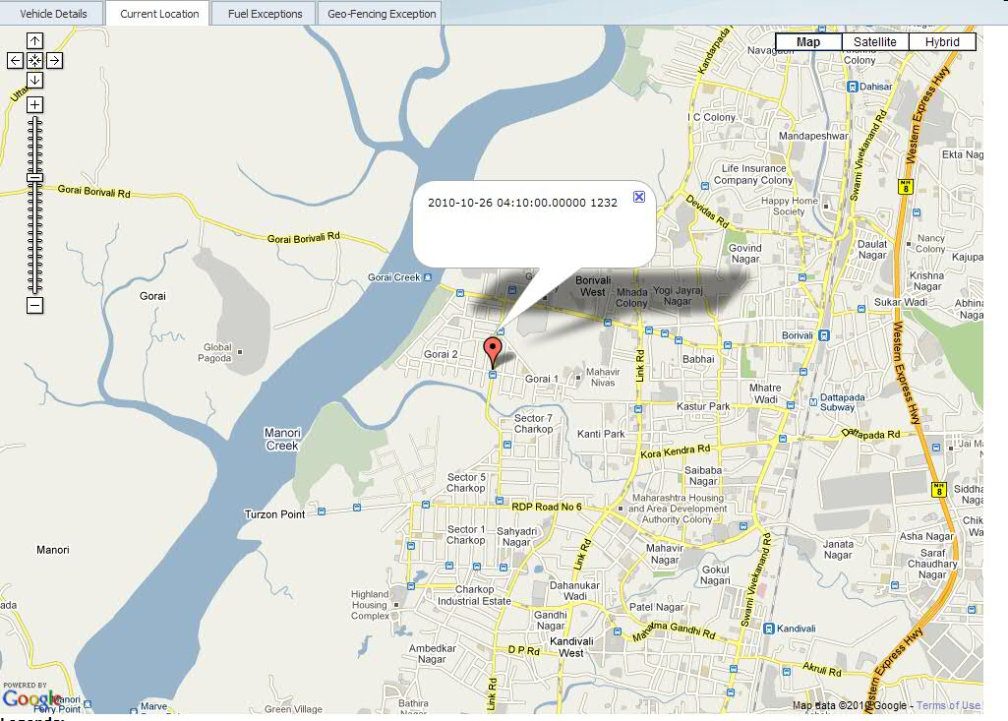
Current Location of Vehicle
GetLastElem function
Notes:
Using timeseries function called getlastelem, one can select the exact current location of vehicle in fraction of seconds from millions of records and display the location on google map. No need to maintain separate column to store current location.

Slide 13
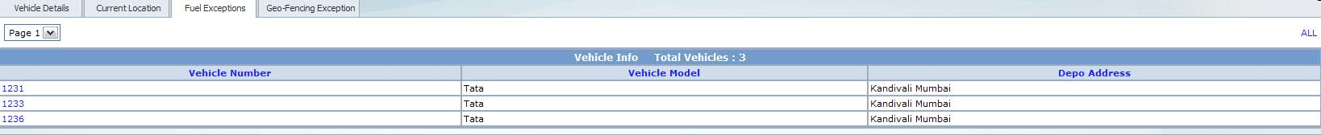
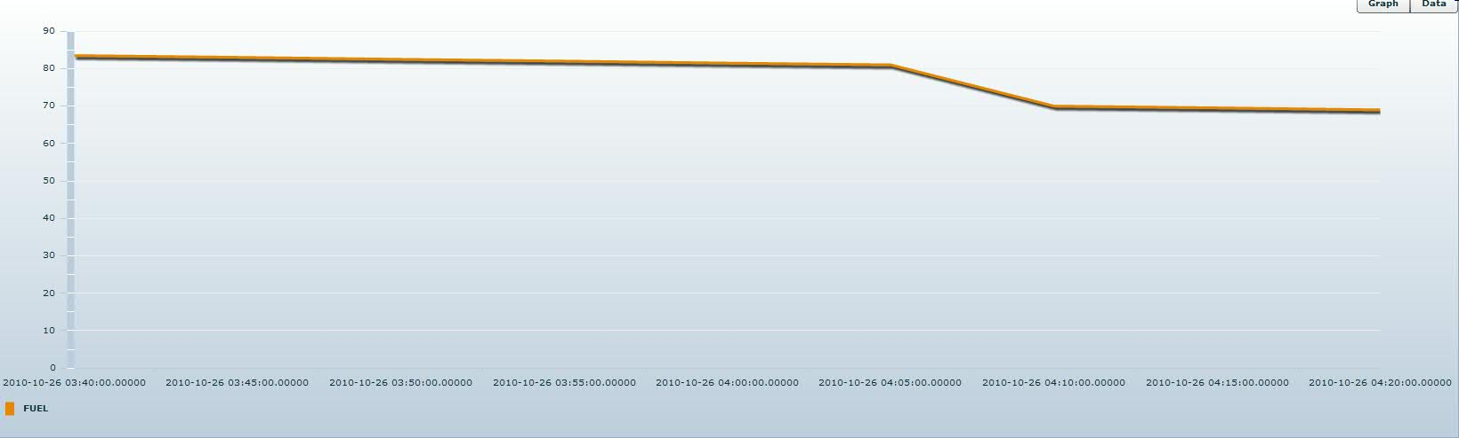
Fuel Exception
Notes:
One of the objective behind implementing vehicle tracking system is to track the fuel consumption abnormality/fuel theft. After clicking on Fuel Exception tab, we get list of vehicles for which system found abnormality in fuel consumption, as in sudden drop in fuel level. After selecting one of the listed vehicle, you can see the graphical representation of fuel consumption pattern. This immediately tells you the time when fuel level dropped abnormally. You can even see the same information in table format by selecting data option on right top corner.

Slide 14
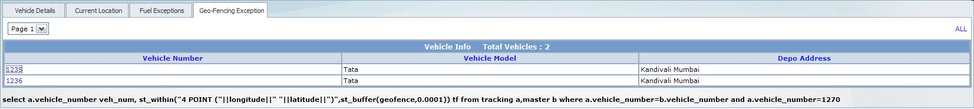
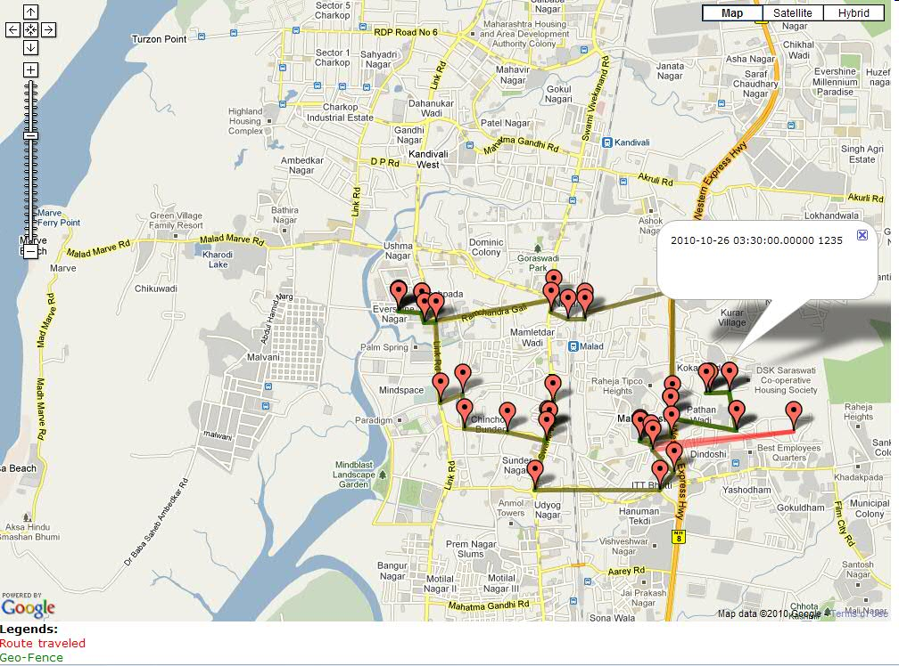
Geo-fencing
ST_Within(cur_location, geofence)
Notes:
Another objective of implementing the vehicle tracking system is to track the vehicle and ensure it doesn’t deviate from its defined route. This is called as Geo-fencing. Using timeseries and spatial feature combination, the implementation of geo-fencing becomes easy. Spatial feature allows you to store the route in one column of vehicle master table in the form of LineString or Polygon. TimeSeries helps in scanning through each records from history very fast and the spatial function st_within helps in checking if the vehicle has broken the define route. Developer need not write any separate routine to check condition of geo-fence.
After clicking on Geo-fencing Exception tab, we get list of vehicles who has broken the geo-fence today. You can select any vehicle from the list to see actual travel details against the designate route.
To show the designated route, you can create kml document using se_askml function provided by spatial feature and display polygon on google map. Or, you can create xml document using se_asgml with some string manipulation function as below:
select replace(replace(se_asgml(geofence),'gml:',''),'<coord>',' <coord>')::lvarchar(8000) geofence from master
and add xml header and footer through your application program. This is certainly faster than traditional RDBM approach.

